Slide 4
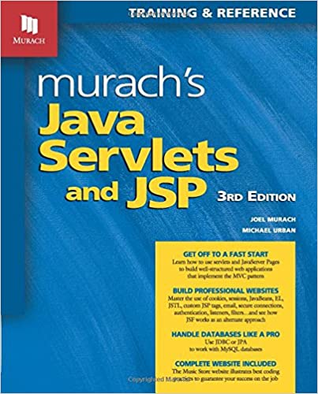
Main Text Book

Slide 5
Background Knowledge
Java
May want to get Java reference
Sun reference page
Basic HTML (including forms and tables)
May want reference
Chapter 4 of text

Slide 6
Assignments
Short programming assignments in core areas
Java Server Pages
Validation/redirection servlets
Session handling
Web Site Project
Multi-page web site in area of your choice
Includes server pages, servlets, and session handling
Should include at least one other advanced capability
Database access
Security
Can be group project: group of 3 students

